Slide 1
BUILD AN EVENT MANAGEMENT SYSTEM USING SALESFORCE
Team Lead: M.Janani Priya
Member 1: K.Deepa
Member 2:D.Igneciya Darthi
Member 3:R.Logeshwari
Member 4:M.Suruthi

Slide 2
Future Scope of Event Management:
Events and festivities are the heart and soul of India. There are thousands of events held every year which are professionally managed. From corporate seminars to diplomatic talks, and from regional fairs to weddings, event management companies plan and organize events of all sorts.

Slide 3
Introduction:
Event management is the application of Project management to the creation and development of small and/or large-scale personal or corporate events such as festivals, conferences, ceremonies, weddings, formal parties, concerts, or conventions. It involves studying the brand, identifying its target audience, devising the event concept, and coordinating the technical aspects before actually launching the event.

Slide 4
The events industry now includes events of all sizes from the Olympics down to business breakfast meetings. Many industries, celebrities, Charitable organizations, and interest groups hold events in order to market their label, build business relationships, raise money, or celebrate achievement.

Slide 5
Purpose:
Event management software companies provide event planning with software tools to handle many common activities such as delegate registration, hotel booking, travel booking, or allocation of exhibition floor space.
A recent trend in event technology is the use of mobile apps for events. This technology is advancing and allowing event professionals to simplify and manage intricate and simple events more effectively. mobile apps have a range of uses.

Slide 6
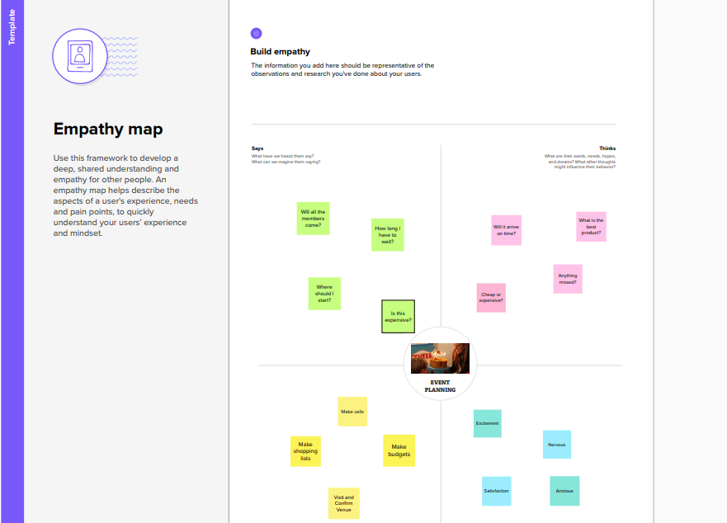
Empathy map:

Slide 7
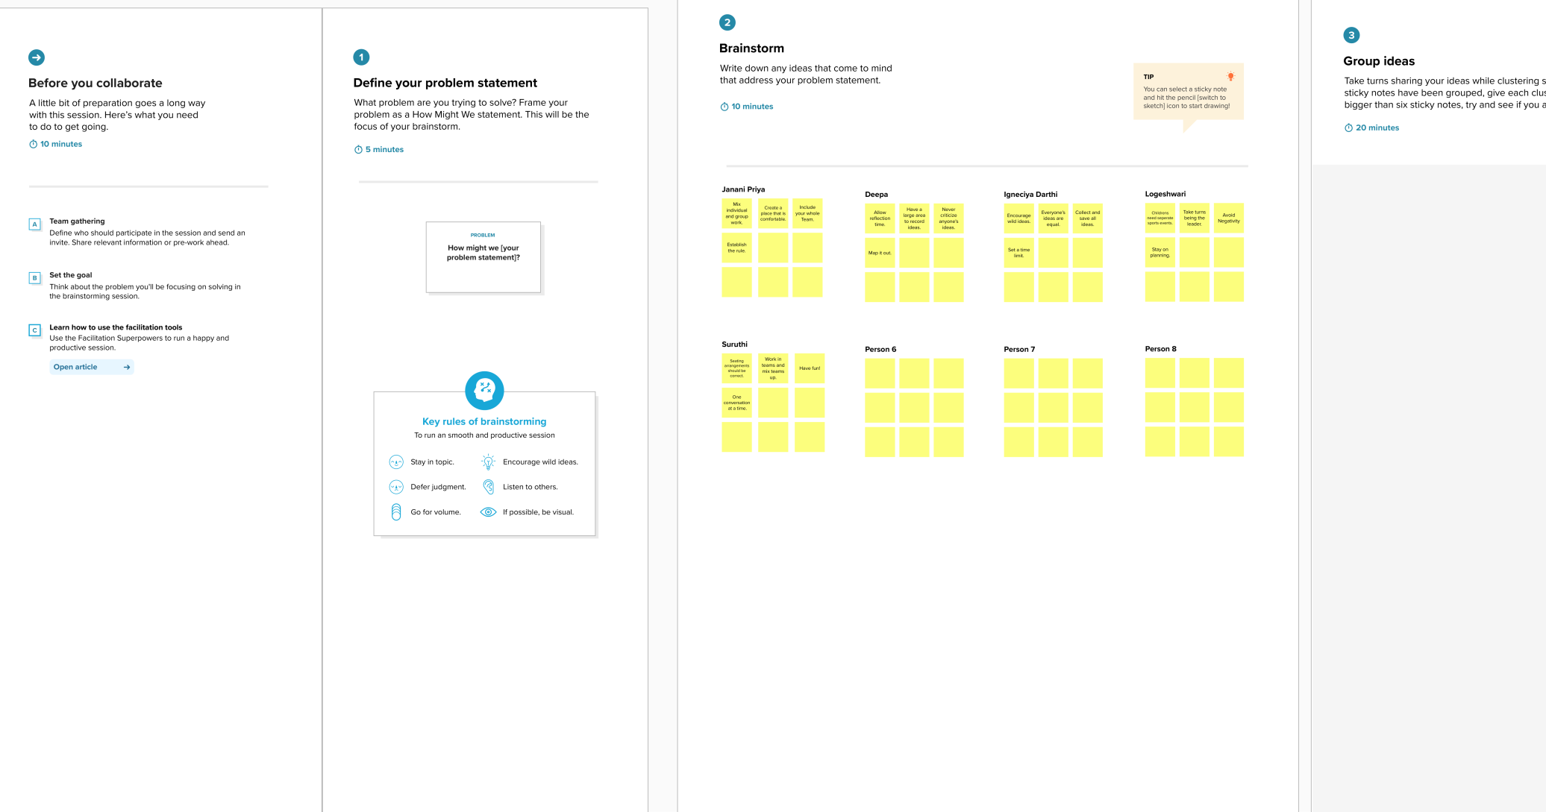
Ideation and Brainstorming map:

Slide 8
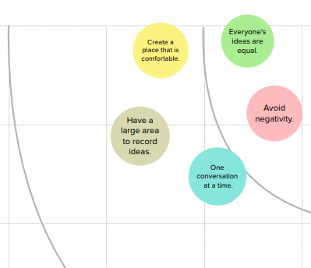

Slide 9
Data model:
Object name | Fields in the Object
EVENT | Field label | Data type
 | City | Text
 | Start Date | Date/ Time
 | End Date | Date/Time
 | Event Name | Master –Detail relationship
 | Event Name | Look-up relationship
ATTENDEE | Field label | Data type
 | ID | Auto number
 | Phone | Phone
 | Email | Email
SPEAKER | Field label | Data type
 | Bio | Text Area
 | e-mail | Email
VENDOR | Field label | Data type
 | e-mail | Email
 | Phone | phone
 | Service provider | Text

Slide 10
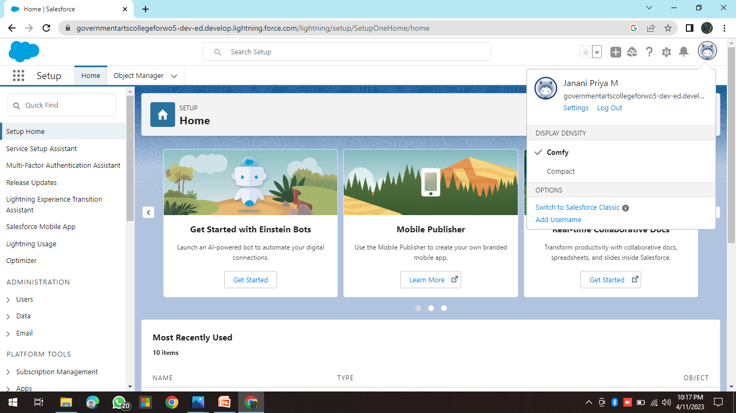
Milestone 1:Creating a salesforce developer org
A Developer org has all the features and licenses you need to get started with salesforce.

Slide 11
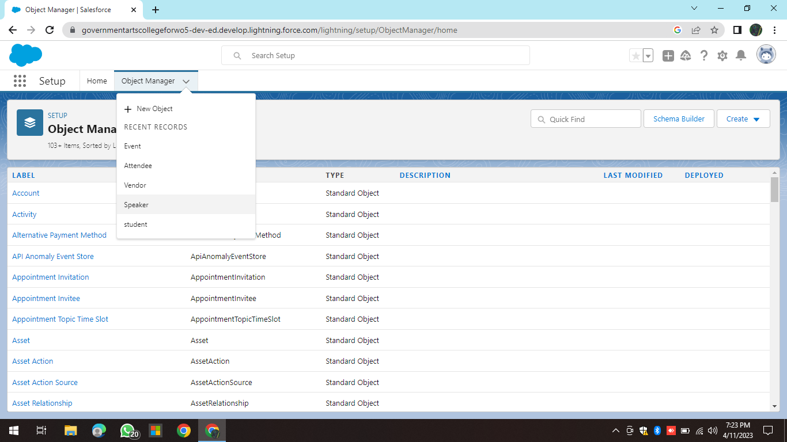
Milestone 2:Object
For this event management we need to create 4 objects i.e, Events, Attendees ,Speakers and Vendors.

Slide 12
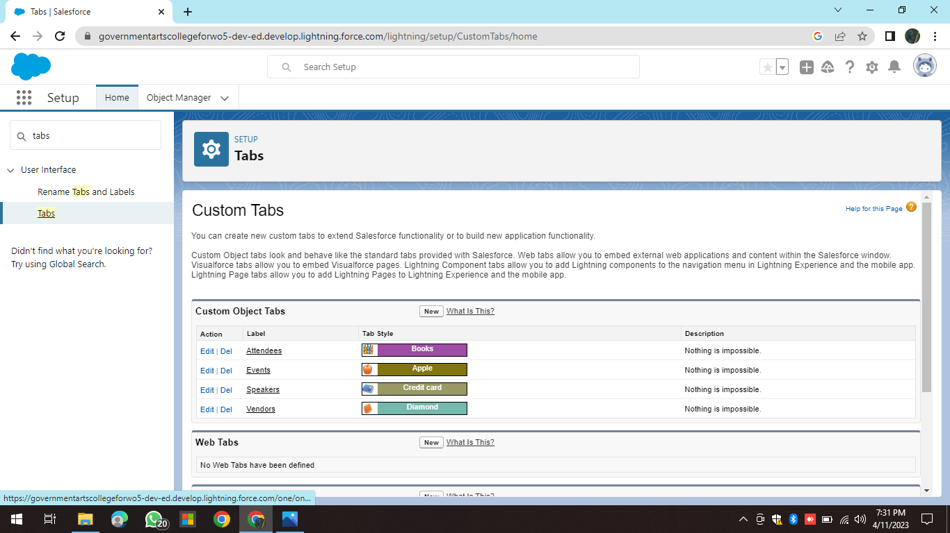
Milestone 3:
Tabs in salesforce help users view the information at a glance. It displays the data of object and other web content in the application.

Slide 13
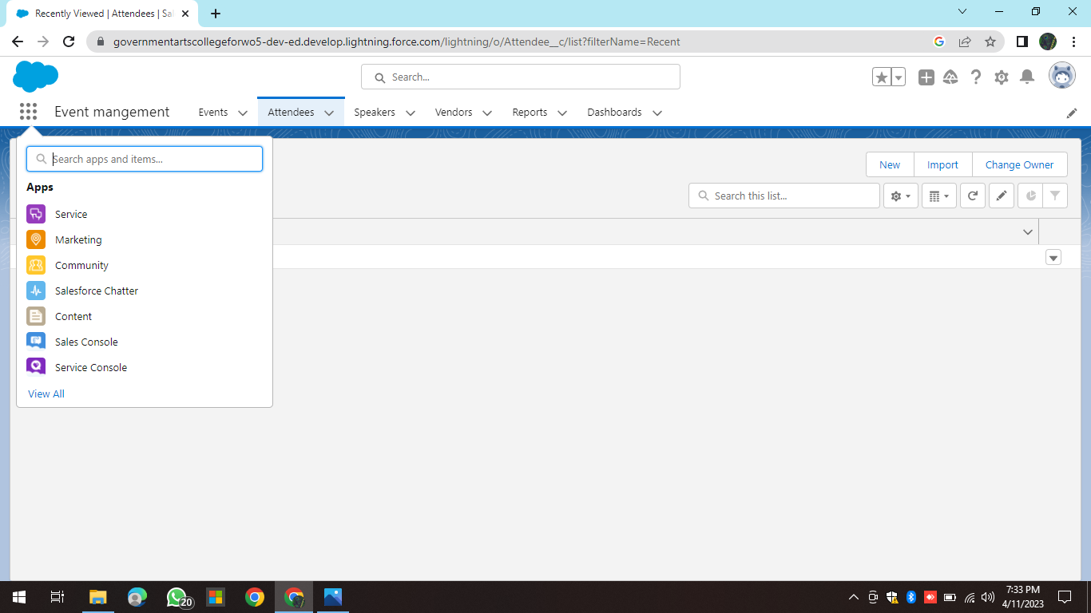
Application:
Apps in salesforce are a group of tabs that help the application function by working together as a unit. It has a name, a logo, and a particular set of tabs.

Slide 14
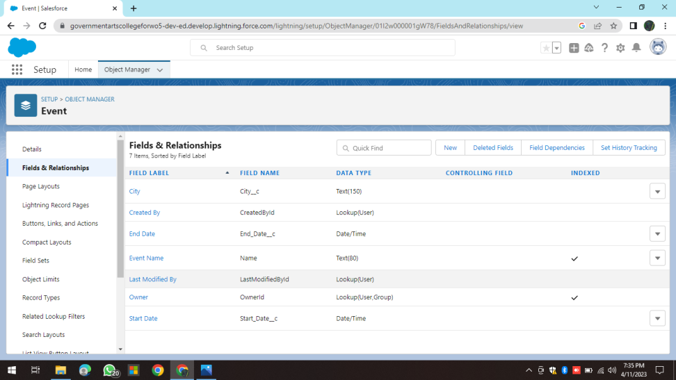
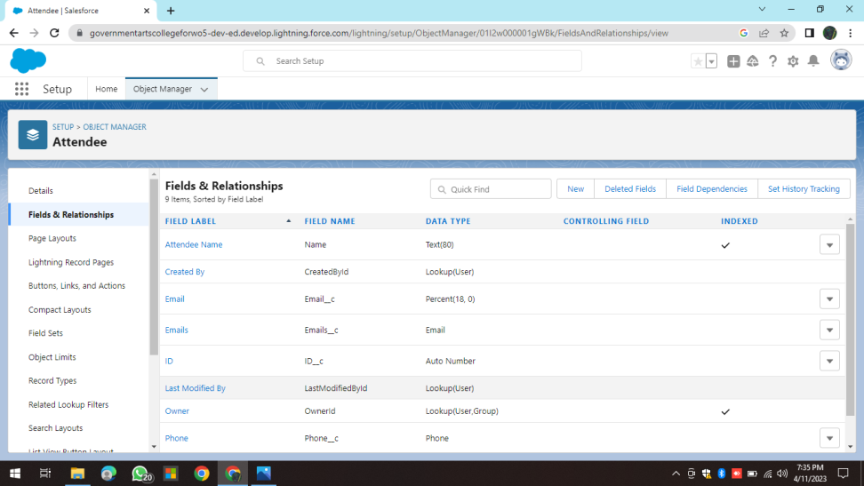
Fields:
Field : Event
Field : Attendee

Slide 15
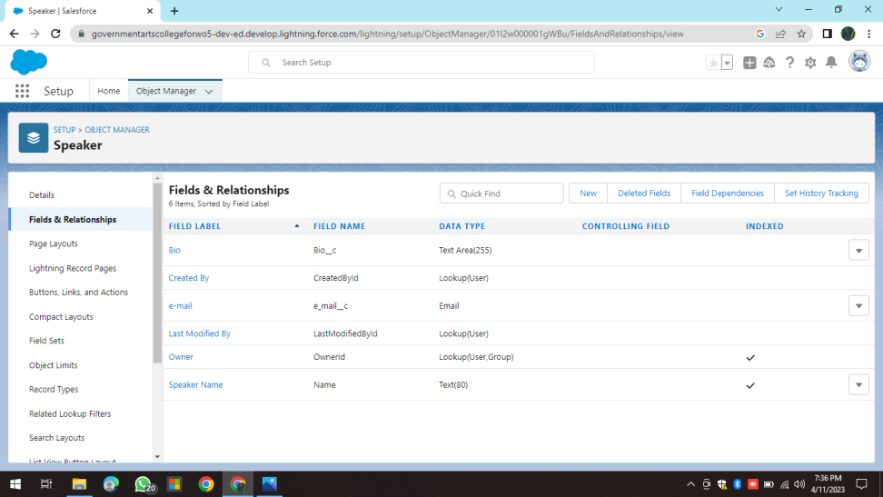
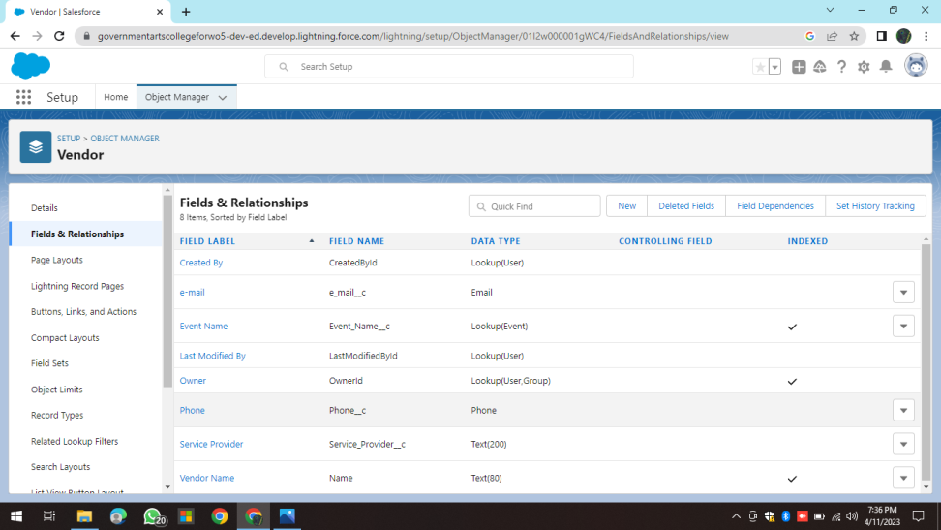
Field : Speaker
Field :Vendor
Fields in salesforce represents what the columns represents in relational databases. it can store data values which are required for a particular object in a record.

Slide 16
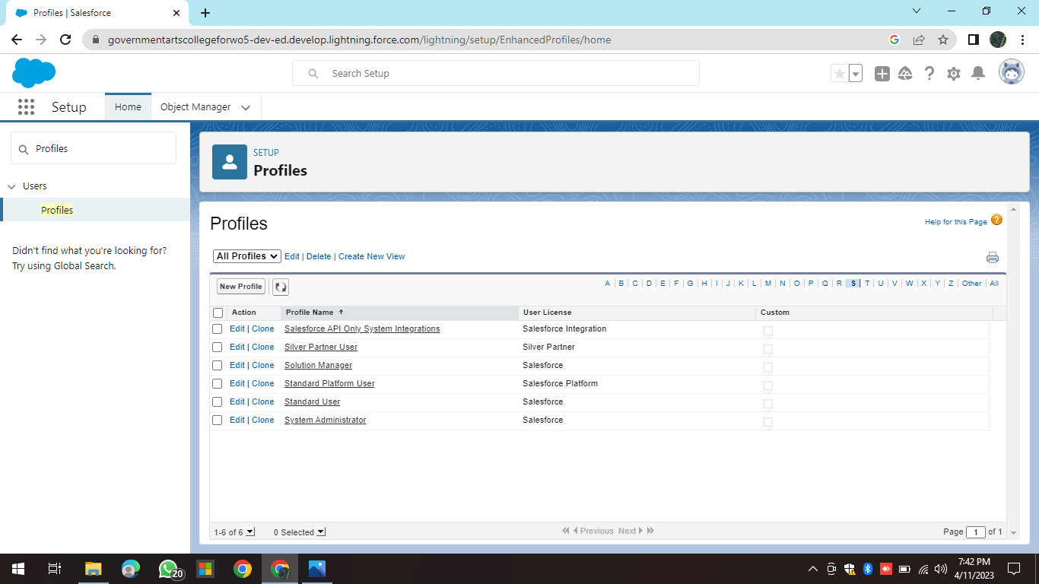
Milestone 5 : Profile
A Profile is group of settings and permissions that define what a user can do in salesforce . A profile controls “Object permissions, User permissions, Tab settings, App settings, Apex class access, visualforce page access, page layouts, Record Types, Login hours & Login IP ranges.

Slide 17
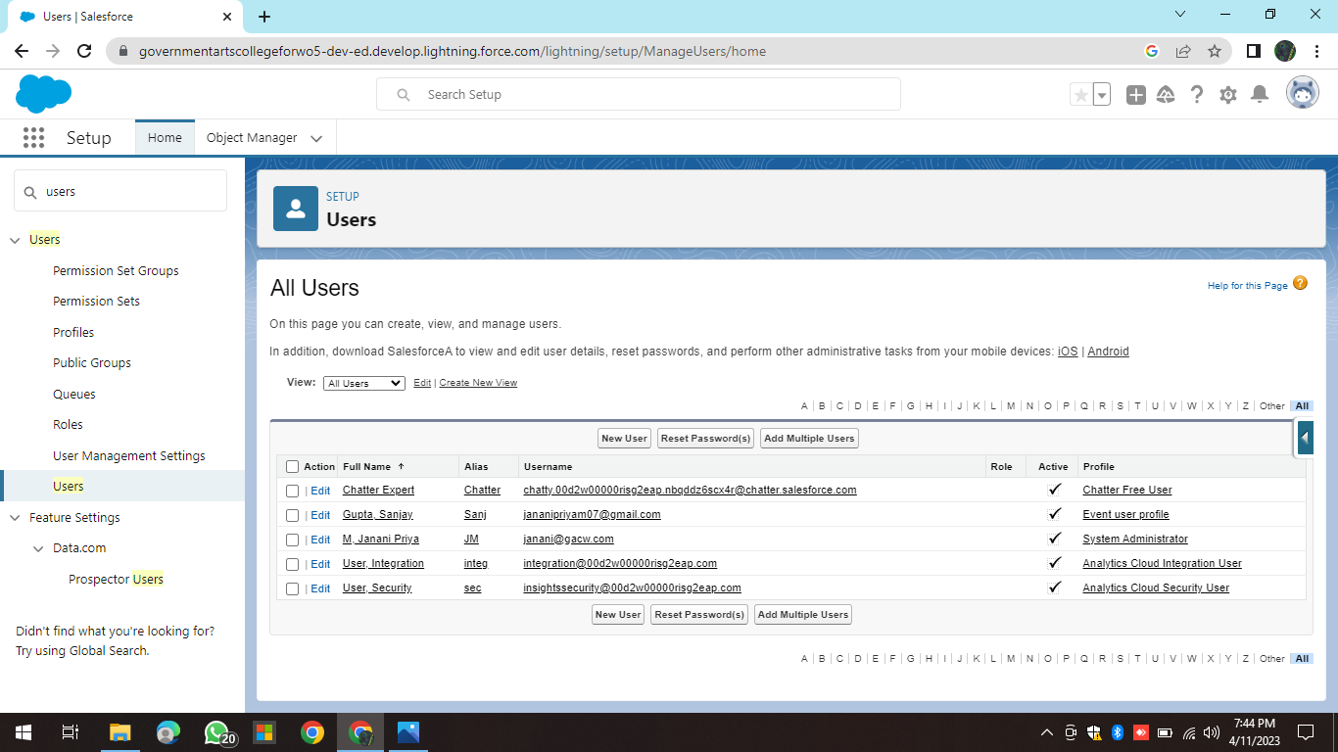
Milestone 6 : User
A User is anyone who logs in to salesforce. Users are employees at your compan, such as sales rep, managers, and IT specialist, who need access to the company’s records. Every user in Salesforce has a user account. The user account identifies the user, and the user account settings determine what features and records the user can access.

Slide 18
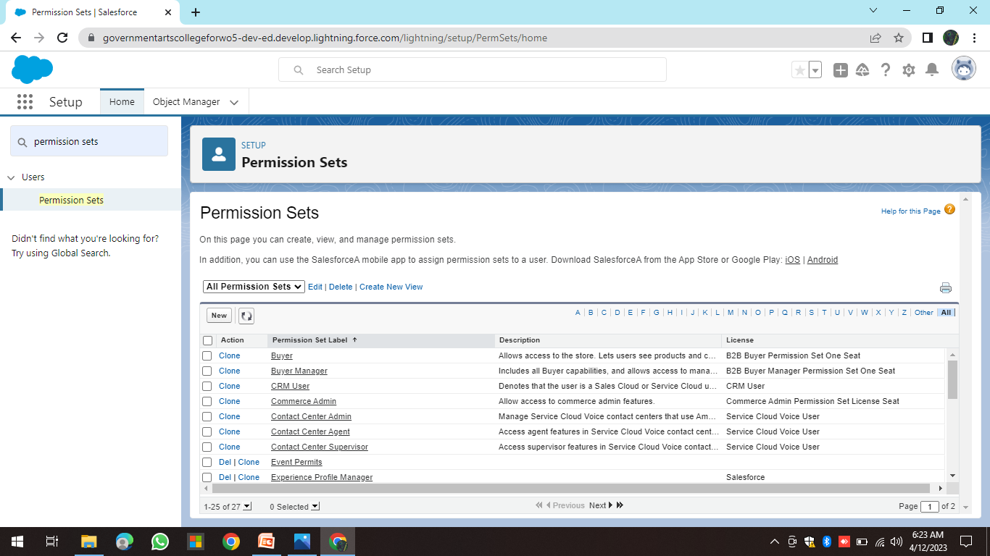
Milestone 7 : Permission sets
A permission set is a collection of settings and permissions that give users access to various tools and functions. Permission sets extend users' functional access without changing their profiles. Users can have only one profile but, depending on the Salesforce edition, they can have multiple permission sets.

Slide 19
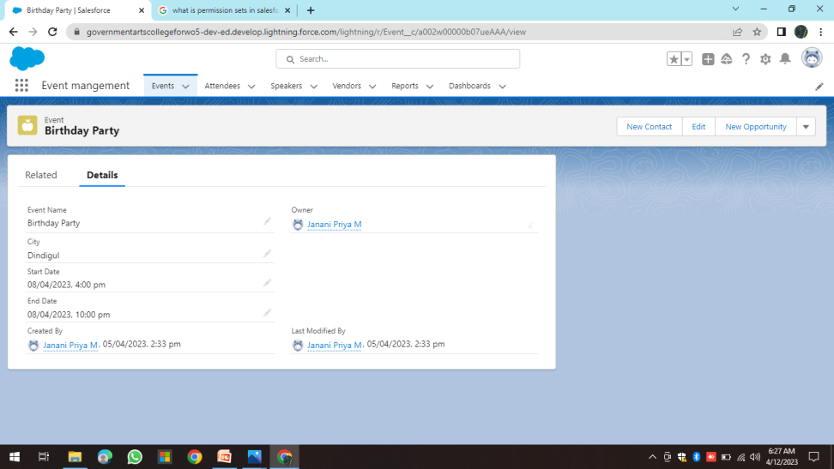
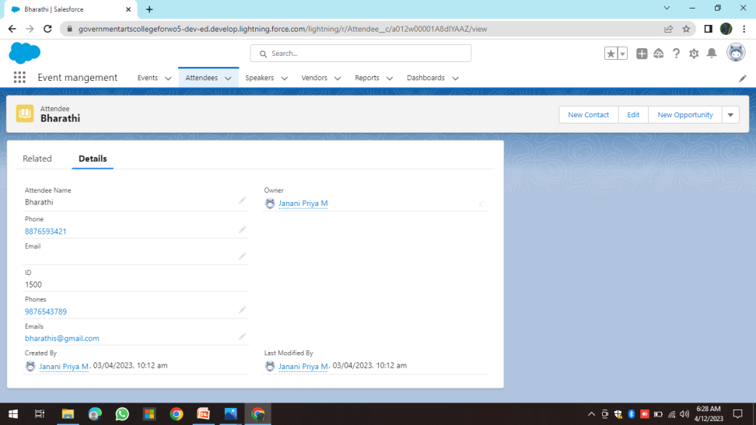
Milestone 8: Reports
Report of Event
Report of Attendee

Slide 20
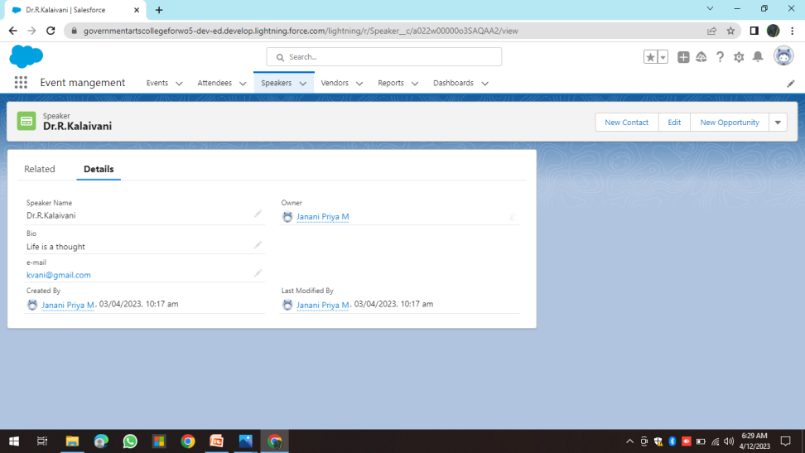
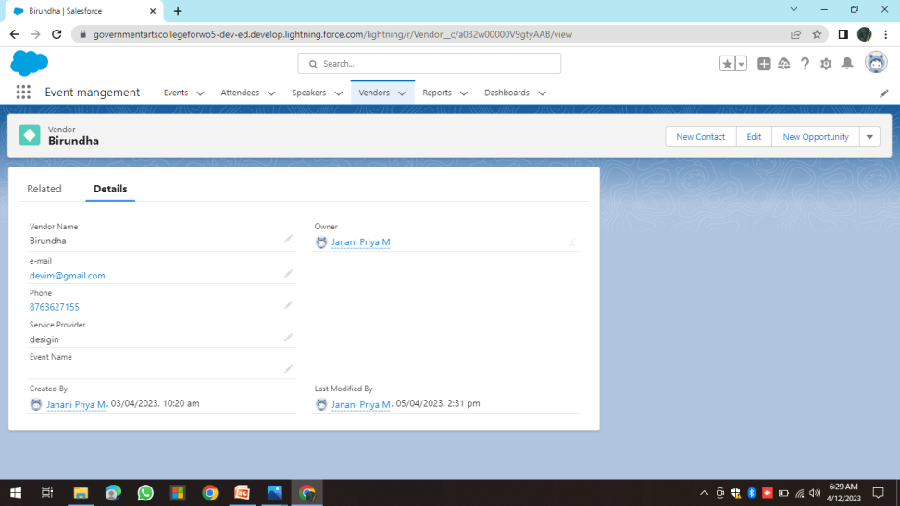
Report of Speaker
Report of Vendor
A report is a list of records that meet the criteria you define. It's displayed in Salesforce in rows and columns, and can be filtered, grouped, or displayed in a graphical chart. Every report is stored in a folder. Folders can be public, hidden, or shared, and can be set to read-only or read/write.

Slide 21
Trailhead Profile Public URL
Team Lead : https://trailblazer.me/id/jananipriyam07 Team member 1: https://trailblazer.me/id/ddineshk5 Team member 2: https://trailblazer.me/id/idarthi Team member 3: https://trailblazer.me/id/rlogeshwari Team member 4: https://trailblazer.me/id/nmsurya

Slide 22
Advantage of Event Management:
1. Easier Management
2. Save Time
3. Cut Costs
4. Increase Engagement
5. Improved Data Collection

Slide 23
Disadvantage of Event Management:
Unconventional work hours. ...
Time away from family and friends. ...
Experience requirements. ...
Job instability. ...
Multiple events at the same time. ...
High level of responsibility…

Slide 24
Application:
Event management is the application of project management to the creation and development of small and/or large-scale personal or corporate events such as festivals, conferences, ceremonies, weddings, formal parties, concerts, or conventions.

Slide 25
Conclusion:
Event Management System is user friendly and cost effective system, it is customized with activities related to event management life-cycle.
It provides a new edge to management industry. Solution Dot always keep your objectives and goals on top priority while developing any plan of work.

